Slide 1
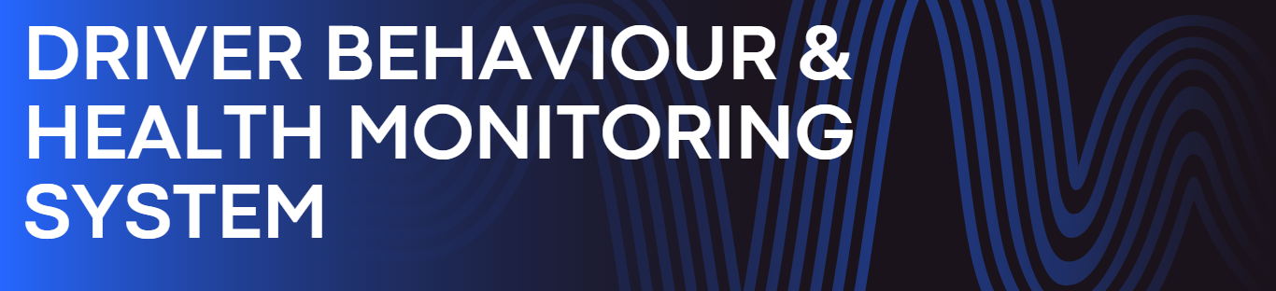

Slide 2
Index
Concept of the project
Problem Statement and Objectives
Proposed Block Diagram
Selected References
Methodology / Initial Design
Basic Implementation

Slide 3
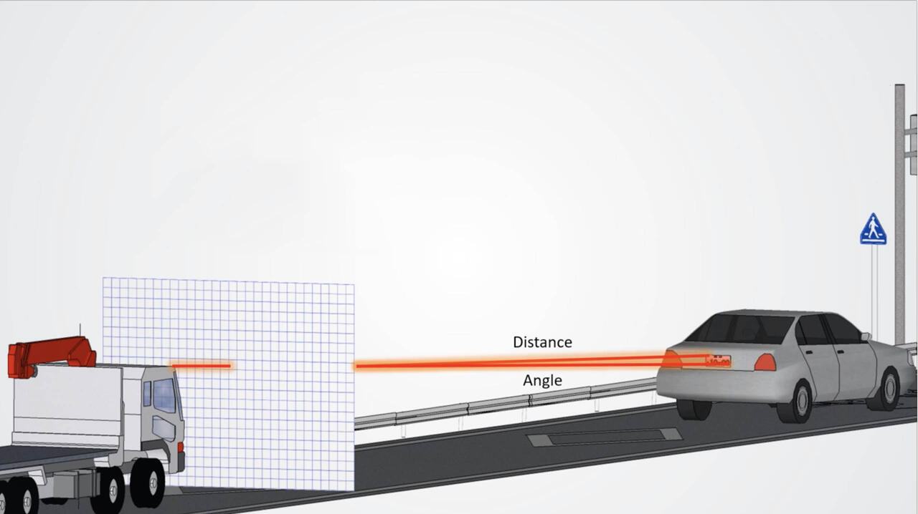
Concept of Project
Most of us at some point have been in a car accident with another driver. Sometimes one or both of the parties involved may have different stories of who was at fault. This leaves the insurers to try to figure things out when processing the claims. So our aim is to use artificial intelligence and Internet of Things to determine what really did happen during the collision.
Also in some cases it’s important to figure out whether it was by mistake or had done it purposely. So our system will detect the Facial expression (pupil position, drowsy driving) of driver, health condition of driver (Blood pressure, Temperature and pulse rate), whether the driver was drunk and the speed of vehicle before collision.

Slide 4
Problem Statement
To develop a system that can accurately analyze and assess the behavior and health of drivers to improve road safety and prevent accidents.
Objective
Determine what really did happen during the collision
Predict the causes of accidents based on various factors.
Analyze whether the accident was unintentional or intentional.
Develop effective accident investigation procedures.
Improve accident analysis methodologies for better insights.

Slide 5
Scope
Develop a system to accurately determine the events that occurred during a collision.
Utilize facial recognition technology to detect driver expressions and eye movements.
Integrate sensors to monitor driver health conditions such as blood pressure, temperature, and pulse rate.
Detect sudden changes in vehicle speed using accelerometer readings.
Implement a cloud-based platform for real-time data storage and analysis.
Provide a user-friendly interface for drivers, administrators, and insurance representatives.
Collaborate with stakeholders such as law enforcement agencies and insurance companies.
Scale the system for integration with existing vehicle technologies and infrastructure.
Improve accident prevention strategies through insights gained from the system.

Slide 6
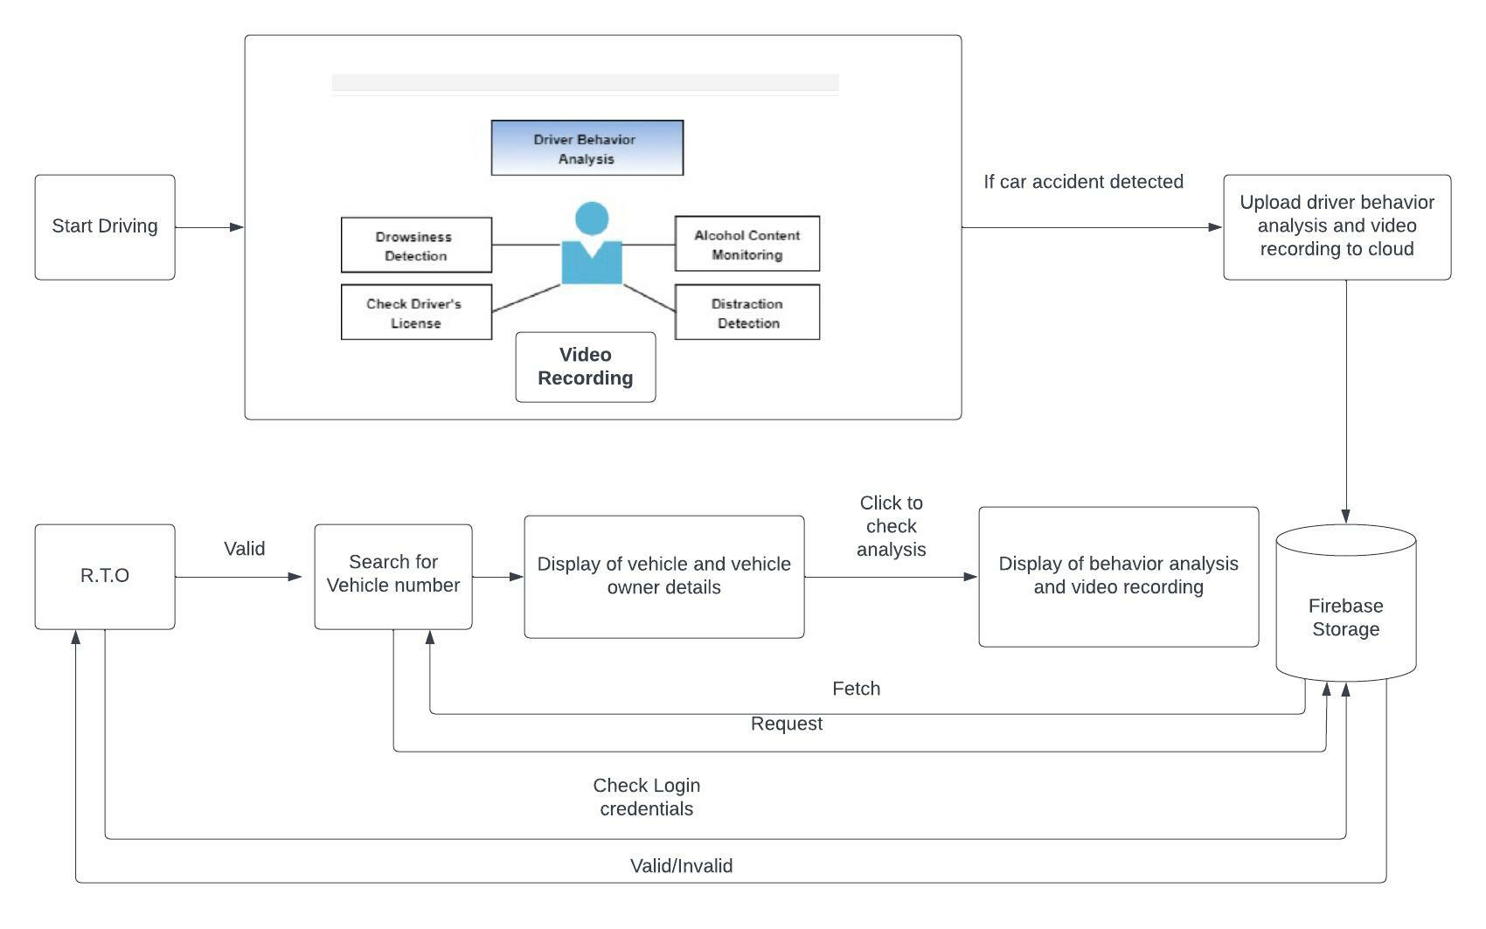
Block Diagram

Slide 7
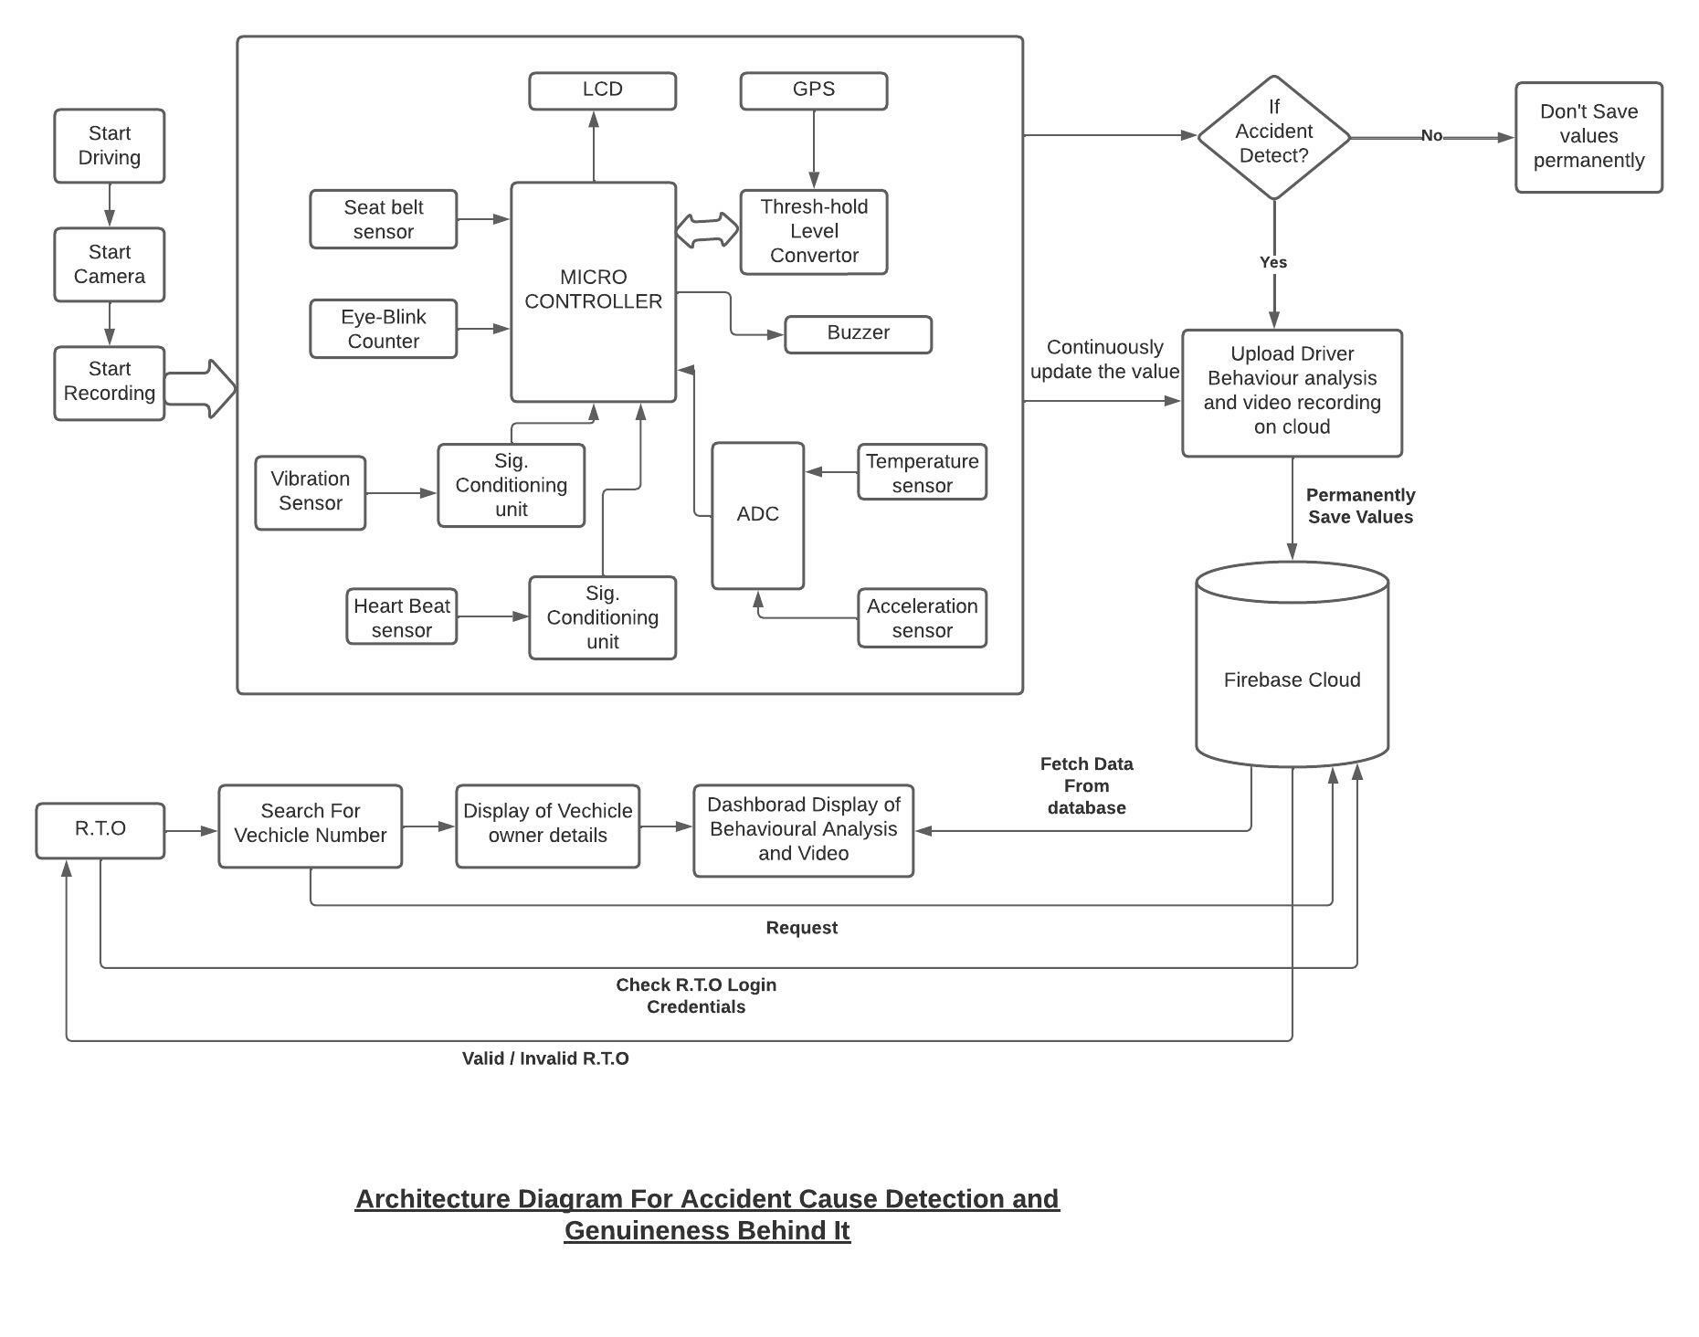

Slide 8
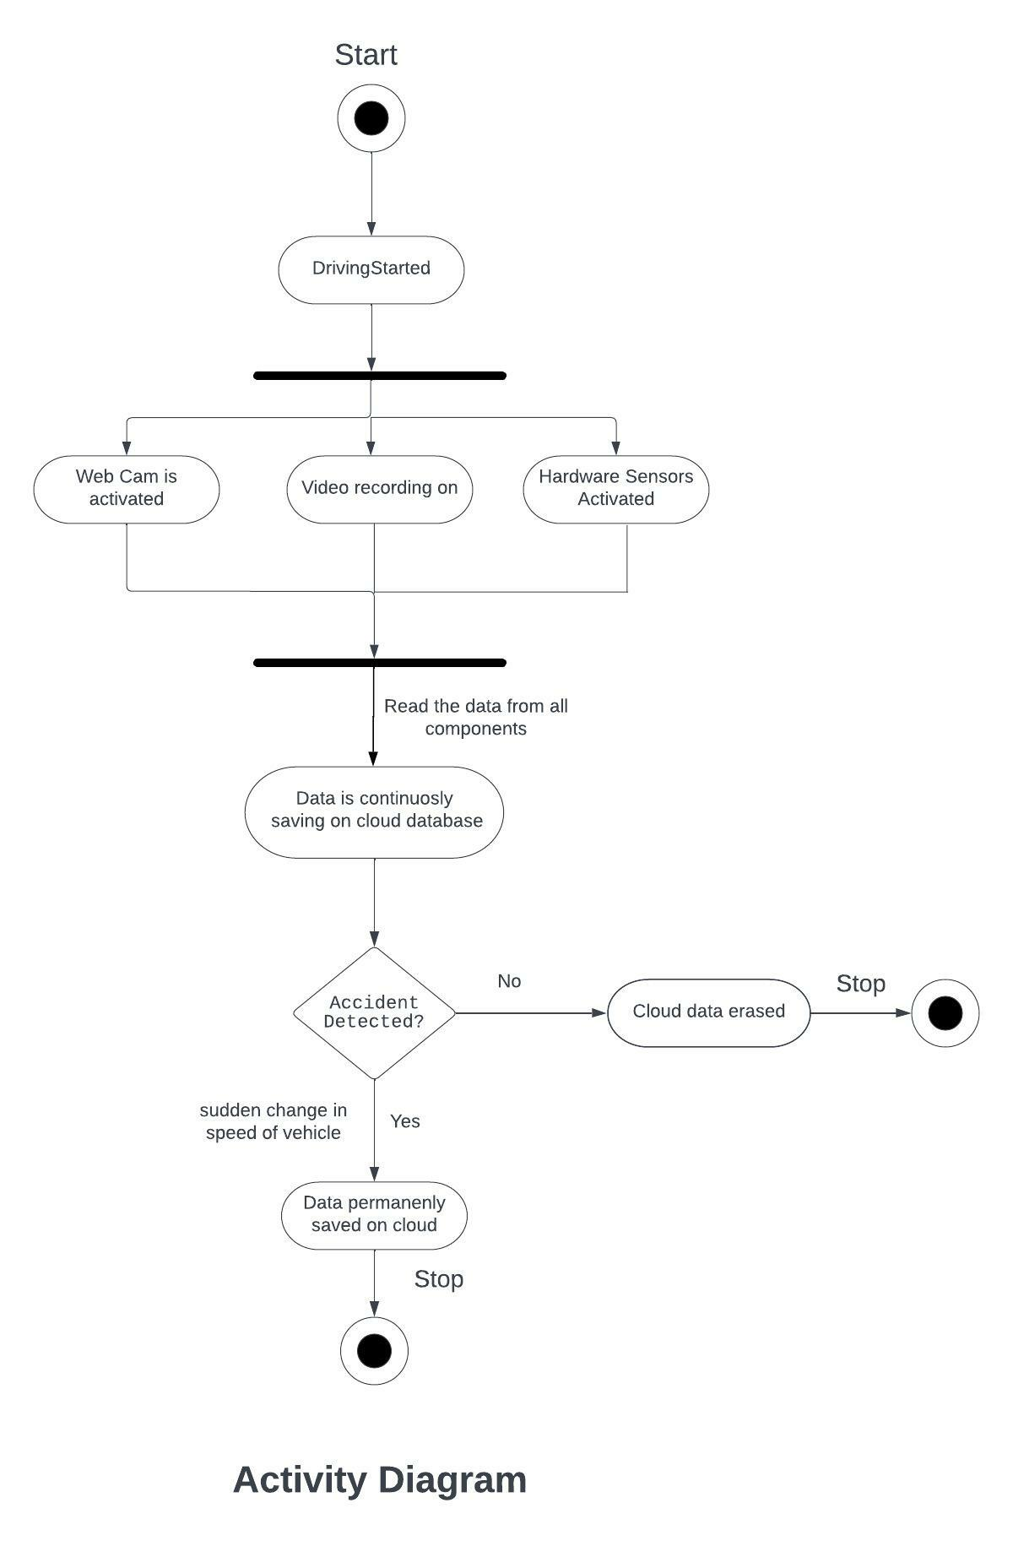

Slide 9
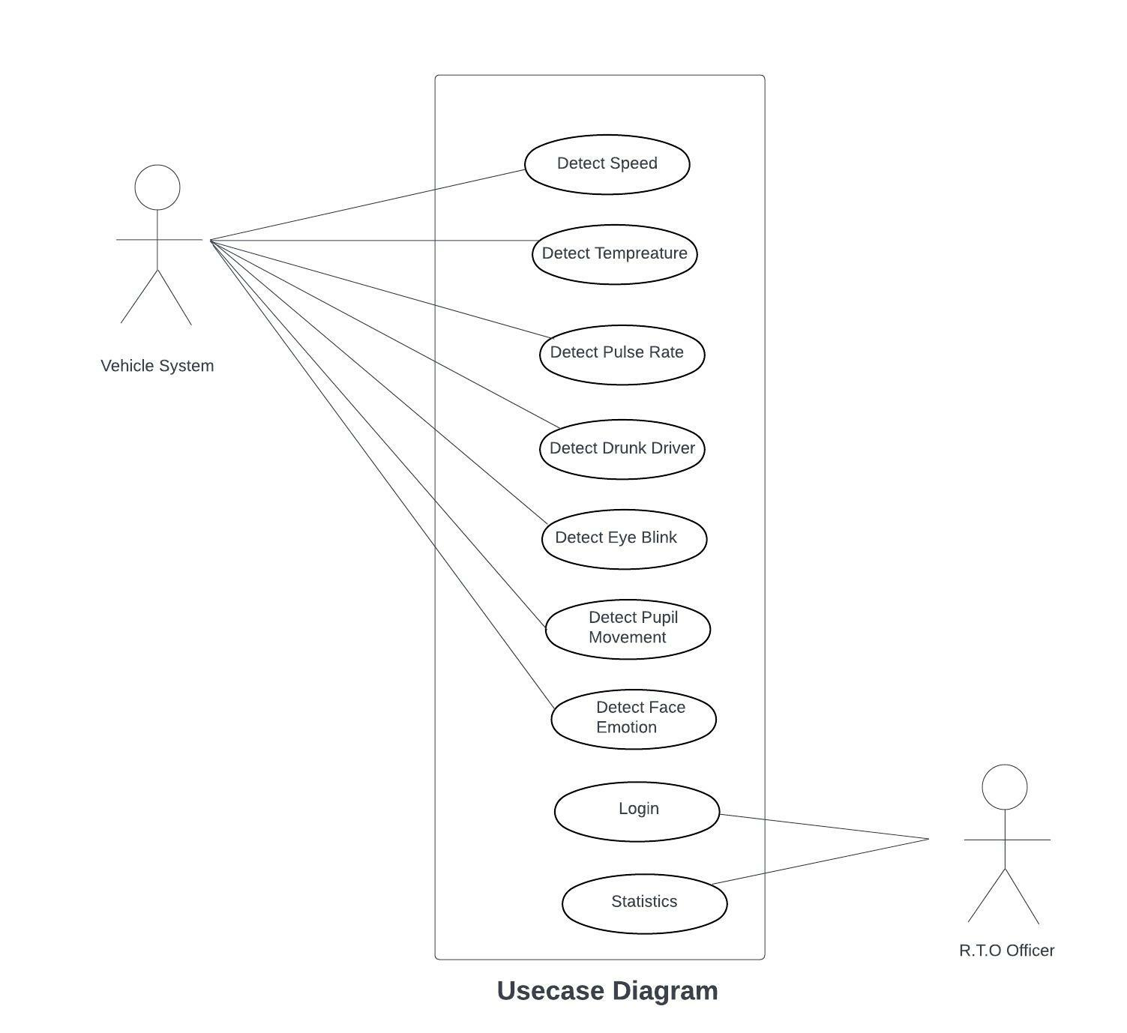

Slide 10
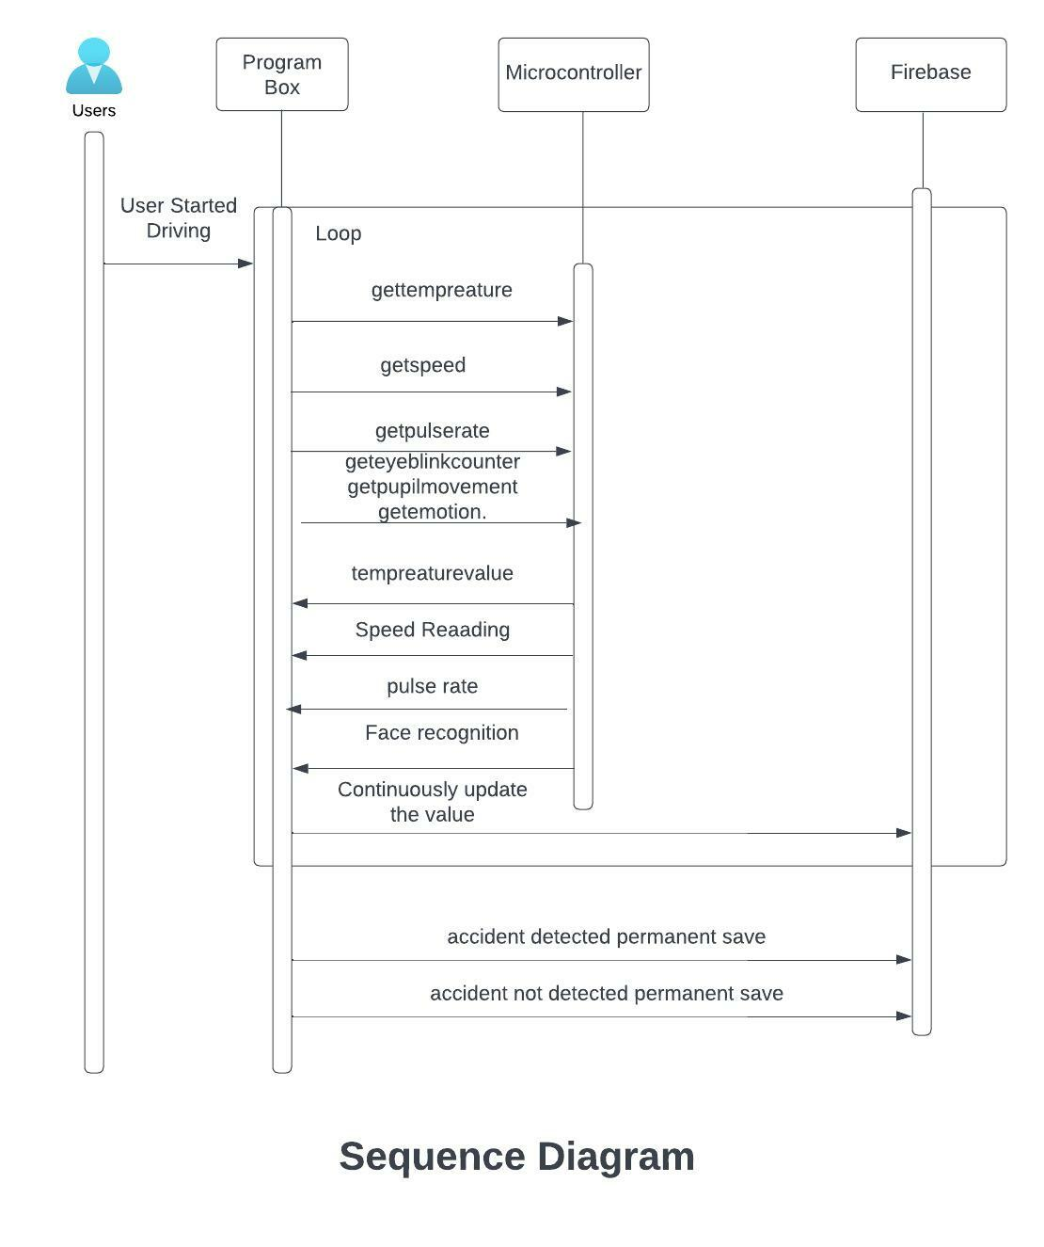

Slide 11
Literature Survey
No. | Title | Date and Journal | Findings
1 | Implementation of Car Black-Box using ARM | March 2018 International Journal of Engineering Research & Technology (IJERT) | Various sensors are used to record different parameters that determines the vehicle status at real time. These measured values will be stored in memory(black box)
2 | FACE DETECTION AND RECOGNITION USING RASPBERRY PI | March 2020 IEEE | Aim to study the paper to understand various techniques of face detection – face detection using haarcascade and face reconginition using EIGEN face approach.
3 | Integrated Accident Prevention Detection and Response System (IAPDRS) | 3, February 2020 International Journal of Engineering and Advanced Technology (IJEAT) | The objective of this paper is to develop a system that can detect and report an accident. Also, this paper provides a method to prevent an accident because of a speed breaker, blind turns, pits, stop signs, etc

Slide 12
No. | Title | Date and Journal | Findings
4 | An Accident Detection and Classification System Using Internet of Things and Machine Learning towards Smart City | 14 Feb 2022 MDPI | the system utilizes a group of sensors including a Hall effect sensor, vibration sensor, accelerometer, flame and smoke sensors, and force and impact sensors. The collected data are sent to a microcontroller for processing and events classification. If an accident is detected, the microcontroller sends an emergency alert through a GSM transmitter.
5 | A Review Paper on Accident Detection System Using Intelligent Algorithm for VANET | May 2020 Journal of Information Engineering and Applications | The use of GSM, GPS, and VANET technologies allows the system to track vehicle and provides the most instant and accurate information about the vehicle accident spot.
6 | Car Accident Detection and Notification System Using Smartphone | 4, April 2015 A Monthly Journal of Computer Science and Information Technology | Speed detection of vechicle as well as video/images and airbag deployment (using smartphone GPS , Accelerometer sensor , Microphone)
7 | Inattentive Driving Detection Using Body-Worn Sensors: Feasibility Study | 29 October 2021 MDPI | The proposed method consists of three detection models, that is, body movement, drowsiness, and inattention detection based on an anomaly detection algorithm

Slide 13
Literature Review
No. | Title | Date and Journal | Findings
8 | Traffic Accident Detection Using Machine Learning Algorithms | 04 Jan 2022 Springer | A vehicular ad hoc network (VANET) can help in reducing accidents by sending safety messages to the vehicles.
9 | Accident and Health Insurance | 24 March 2022 IEEE | The residual systemic risk that cannot be absorbed by the policies and the necessity to generate wider and superior insurance service are at the basis of the call for regulation of the insurance business.
10 | Aircraft Black Box | LongDom | black box flight recorder is heavily protected recording device, similar to a hard disk or a memory card

Slide 14
Approach
As discussed above our main aim is to detect or find out all the causes of road accident and genuineness behind accident, we are going to detect accident related factor such as sudden speed/acceleration change ,whether driver is drunk , whether driver is feeling uncomfortable or unwell it be can due to rise in blood pressure any kind of health issue or tension related to job or personal life.
We are going to detect all the above factors by using sensors such as photoplethysmographic sensor(blood pressure detection), MQ-3 Sensor(alcohol detection), TMP36(temperature detection) and speed change detection using accelerometer.
We are going to detect the face by using python with haarcascade. Python program is designed to detect eye blinks so the eye blink counter is updated in firebase database, pupil movement either left or right and face emotion detection we will also de to check the accident causes.
Python program is designed to read the value from Arduino and continuously update the value in firebase.
When car is started after that when if there is sudden change in speed of car that will detected by accelerometer. Sudden change in accelerometer means the accident is occur.

Slide 15
Hardware & Software requirements
Hardware Requirement:
Arduino Board, Webcam.
photoplethysmographic sensor(blood pressure detection), MQ-3 Sensor(alcohol detection), TMP36(temperature detection) and speed change detection using accelerometer.
A Laptop/Computer for managing and working with project
Processor
RAM(Random Access Memory)
Software Requirement:
Python, Firebase, Pycharm, Flask.
A web server for hosting website

Slide 16
Thanks

